Slide 1

Deep Learning-Driven Pest Detection and Classification with Instant SMS Alerts for Precision Agriculture
GUIDE
Mr. Ramesh R
Srinivasa Ramanujan Centre
SASTRA Deemed to be University
Presented By:
Ch. Hemanth Sai Nag – 226003030
D. Deepak Reddy – 226003039
G. Sai Aasish – 226003050

Slide 2
Contents
Base paper Title and Info
Abstract
Problem Statement
Literature Survey
Work Plan
Methodology Explanation
Architecture Diagram
Dataset description
Workflow
Full implementation
Result
Conclusion

Slide 3
BASE PAPER DETAILS
Title : Pest classification: Explainable few-shot learning vs. convolutional neural networks vs. transfer learning.
Journal Name : Scientific African
Publisher : Elsevier
Published Year : 2025

Slide 4
ABSTRACT
Pest detection in agriculture is vital for maintaining crop health and improving yield, particularly in environments with limited labeled data and real-time constraints. Few-Shot Learning (FSL) is applied in scenarios with small datasets, offering the ability to learn and generalize from very few examples. For larger datasets, Vision Transformers (ViT) are utilized for their strong global feature extraction capabilities. Graph Neural Networks (GNNs) convert images into graph structures to capture spatial and relational patterns, while Self-Supervised Learning (SSL) enhances model performance by learning from unlabeled data, reducing the need for extensive manual annotation. To ensure efficient on-device inference, TensorFlow Lite is used to optimize models for mobile and edge environments. Real-time video feeds are processed using OpenCV for immediate analysis. A lightweight and interactive web application is developed using Streamlit, offering features such as live camera feed, image upload, and video upload for flexible data input. Detected pests are automatically communicated to farmers via WhatsApp messaging, enabling timely intervention. This integrated system combines state-of-the-art deep learning techniques with real-time processing and user-friendly deployment, providing an effective and scalable solution for intelligent pest management in agriculture, while evaluating the performance of FSL compared to other advanced models.

Slide 5
PROBLEM STATEMENT
Pest detection in agriculture is critical for crop protection but is limited by the scarcity of annotated data and the need for real-time analysis. Traditional deep learning models require large datasets and computational resources, making them unsuitable for field deployment. Farmers in rural or resource-constrained areas lack access to such advanced tools. There is a need for a lightweight, adaptable, and efficient pest detection system that works with minimal labeled data.

Slide 6
OBJECTIVE
This work aims to develop a pest detection framework using Few-Shot Learning, enabling accurate identification with limited labeled samples. Vision Transformers and Graph Neural Networks are utilized to enhance representation and spatial understanding of pests. Self-Supervised Learning techniques are incorporated to reduce dependency on manual annotation. The final system is optimized for real-time use on edge devices, with a user friendly interface and automated alert system.

Slide 7
LITERATURE REVIEW
Title | Author | Published Year | Methodology | Journal | Merits | Demerits
1. Detection of mulberry ripeness stages using deep learning models | Seyed-Hassan Miraei Ashtiani | 2021 | The study employs deep learning models, specifically Convolutional Neural Networks (CNNs), to classify mulberry ripeness stages based on image data. | IEEE | The proposed CNN-based approach achieves high accuracy in classifying mulberry ripeness stages, demonstrating the effectiveness of deep learning in agricultural applications. | The study may face challenges related to the generalization of the model to different environmental conditions and the need for a large dataset to train the deep learning model effectively

Slide 8
Title | Author | Published Year | Methodology | Journal | Merits | Demerits
Machine Learning based Pest Identification in Paddy Plants. | Vivek Agnihotri | 2019 | The authors propose an OTA-C (Operational Transconductance | IEEE | The proposed design offers a flexible approach to implementing fractional-order filters. | The practical implementation of fractional-order capacitors can be challenging.
AMN: Attention Metric Network for One-Shot Remote Sensing Image Scene Classification. | Yonghao Xu | 2020 | The authors propose the Attention Metric Network (AMN), a deep learning model. | Remote Sensing | The AMN model enhances feature representation by focusing on the most relevant parts of an image | The study may face challenges in generalizing the model to diverse remote sensing datasets due to potential overfitting.

Slide 9
Title | Author | Published Year | Methodology | Journal | Merits | Demerits
Multi-Domain Few-Shot Learning and Dataset for Agricultural Applications | Sai Vidyaranya Nuthalapati | 2021 | Introduces a group-aware contrastive network using context graphs. | IEEE | One merit of this method could be its innovative approach to person re-identification using group-aware contrastive networks. | A potential demerit could be the complexity of implementing and fine-tuning such a specialized network
Insect Pest Detection and Identification Method Based on Deep Learning for Realizing a Pest Control System | Hiroaki Kuzuhara | 2020 | The authors propose a two-stage detection and identification method for small insect pests utilizing Convolutional Neural Networks (CNNs). | SCI-E | A significant advantage of this method is its ability to accurately detect and identify small insect pests, which are often challenging to recognize. | A potential drawback is that the two-stage process may result in increased computational complexity and longer processing times.

Slide 10
Title | Author | Published Year | Methodology | Journal | Merits | Demerits
Few-shot learning for image-based bridge damage detection | Yan Gao | 2023 | Few Shot learning | Elsevier | Train model with few number of images | It’s not sure we can get more accuracy than general deep learning model.
Crop pest classification based on deep convolutional neural network and transfer learning | K. Thenmozhi | 2019 | Convolution Neural Network(CNN) | Elsevier | Training is very easy to implement. | We can’t get best efficiency by this model

Slide 11
Title | Author | Published Year | Methodology | Journal | Merits | Demerits
Vision transformer-based visual language understanding of the construction process | Bin Yang | 2024 | Vision transformer | Elsevier | Vision Transformers apply this architecture to image data, treating the image as a sequence of patches instead of a grid of pixels. | They still underperform CNNs when training data is very limited. Without sufficient data, the attention model tends to overfit.

Slide 12
Work Plan
Timeline/ Process | 1-10 days | 10-20 days | 20-30 days | 30-45 days | 45-60 days
Data Collection
Data Pre-processing
Split the data
Train FSL, GNN, Vit
Train SSL and combine model
OpenCV
Final Output

Slide 13
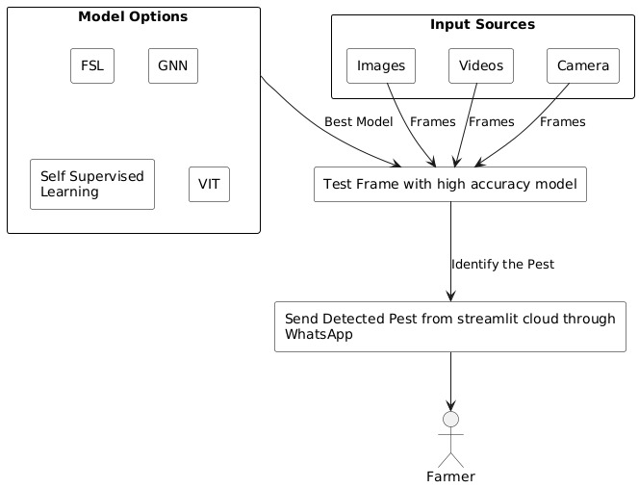
ARCHITECTURE DIAGRAM

Slide 14
Dataset Description
pest/
│── train/
|-aphids
|- armyworm
|- beetle
|- bollworm
|- grasshopper
|- mites
|- mosquito
|- sawfly
|- stem borer
│── test/
|-aphids
|- armyworm
|- beetle
|- bollworm
|- grasshopper
|- mites
|- mosquito
|- sawfly
|- stem borer

Slide 15
WORK FLOW DIAGRAM
Data Collection
Split the data
Train Individual model
Train combine model
Compare model

Slide 16
Evaluate model
Integrating Camera
Final Output

Slide 17
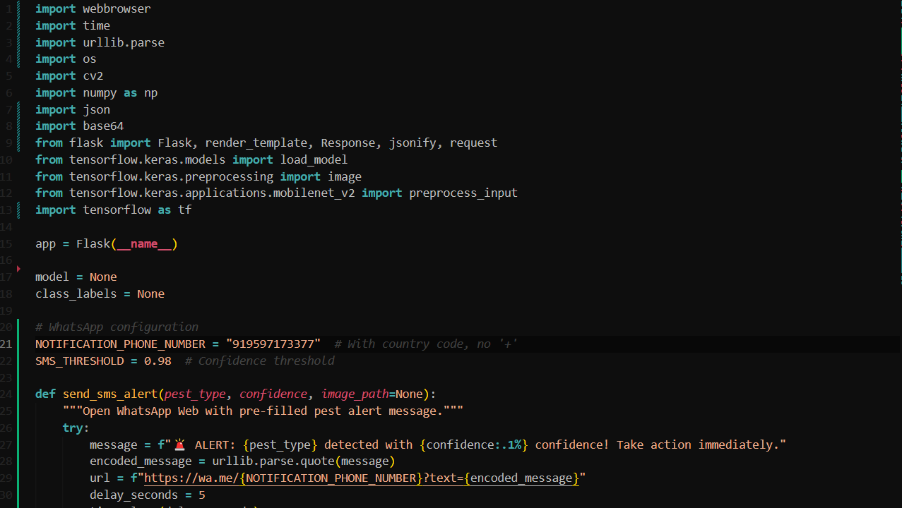
FULL IMPLEMENTATION

Slide 18
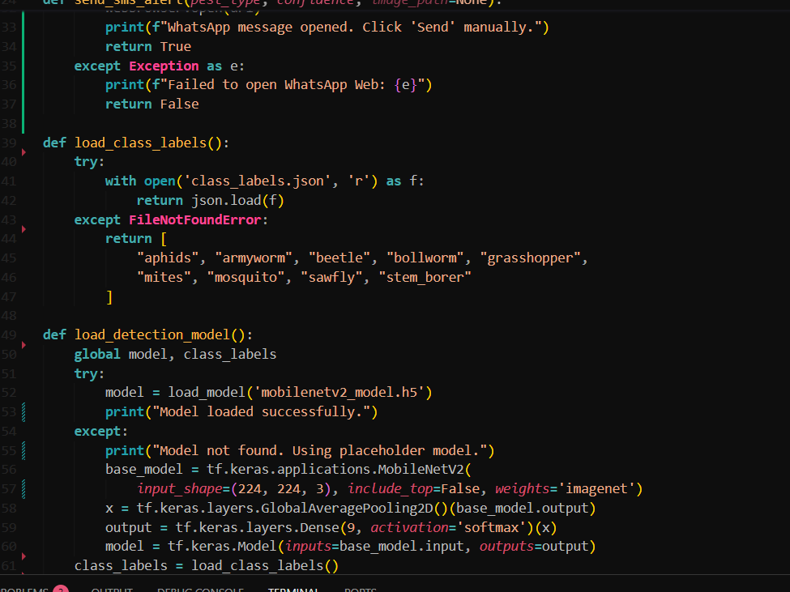
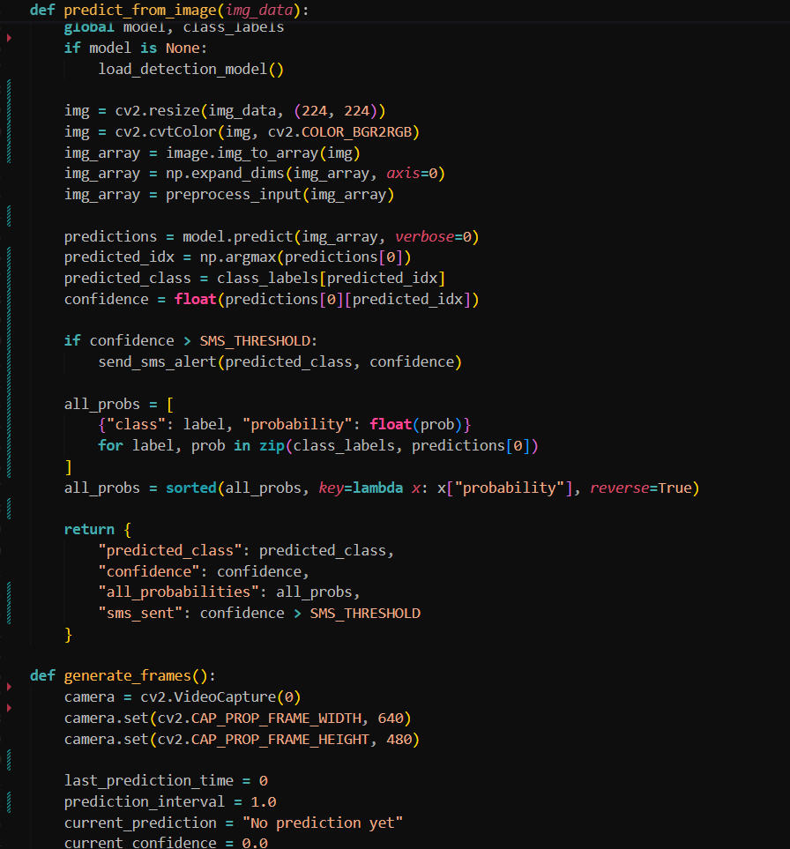

Slide 19
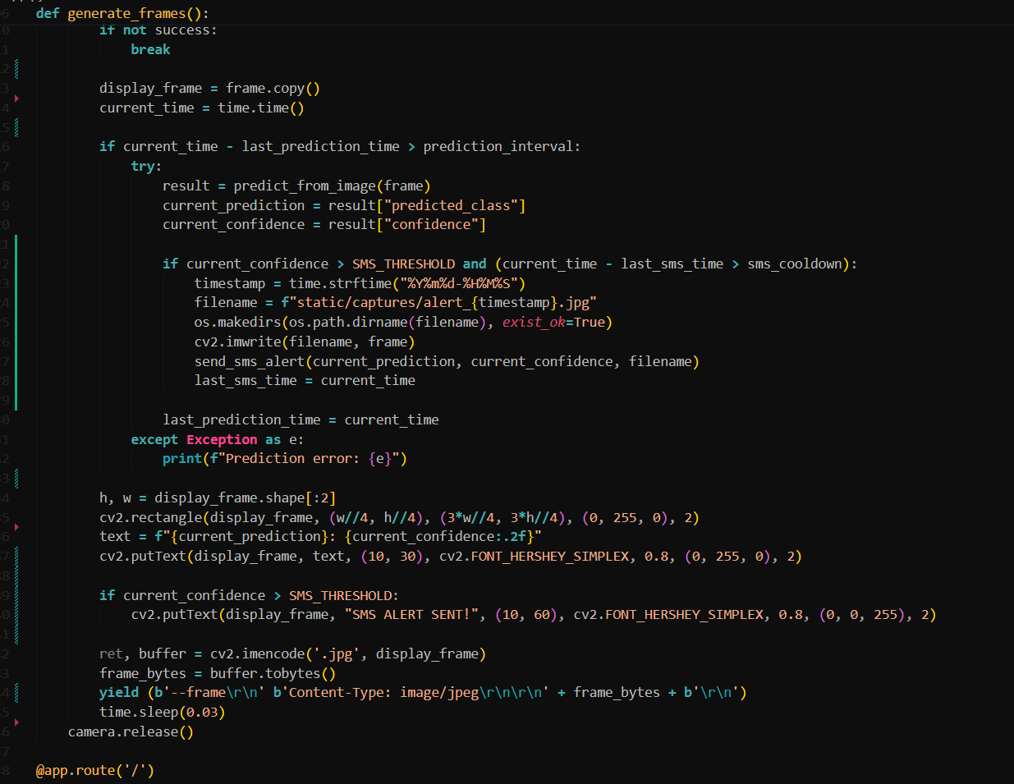

Slide 20
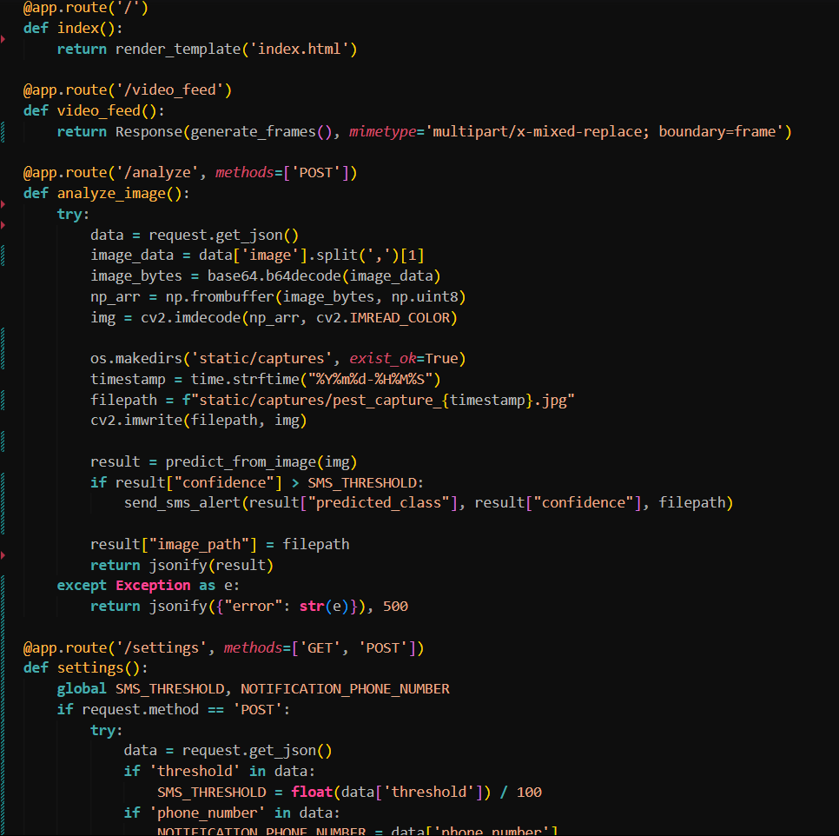

Slide 21
MODULES USED
Load TensorFlow data
Build mobilenetv2 model, train mobilenetv2 model
Euclidean distance, build Siamese base, build Siamese model,
Create pair, load image from directory.
Prepare pair of models, classify with Siamese, train Siamese network
Train GNN model.
Vit model.
Main module
OpenCV for using camera for classifying pest
Whatsapp for sending messages
Streamlit for Interface

Slide 22
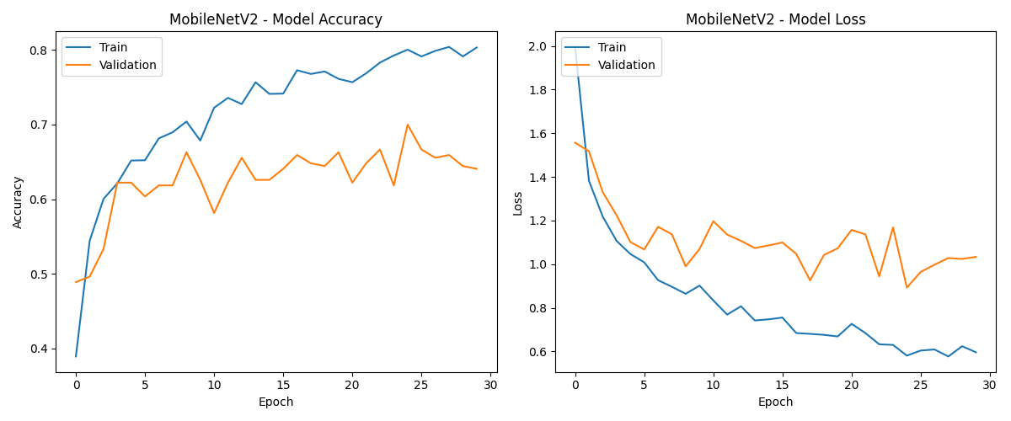
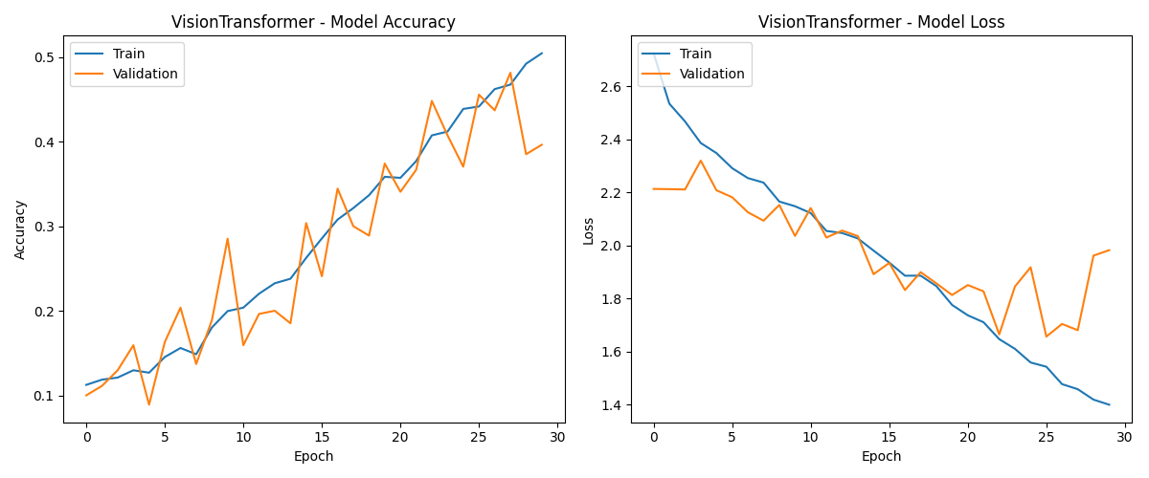
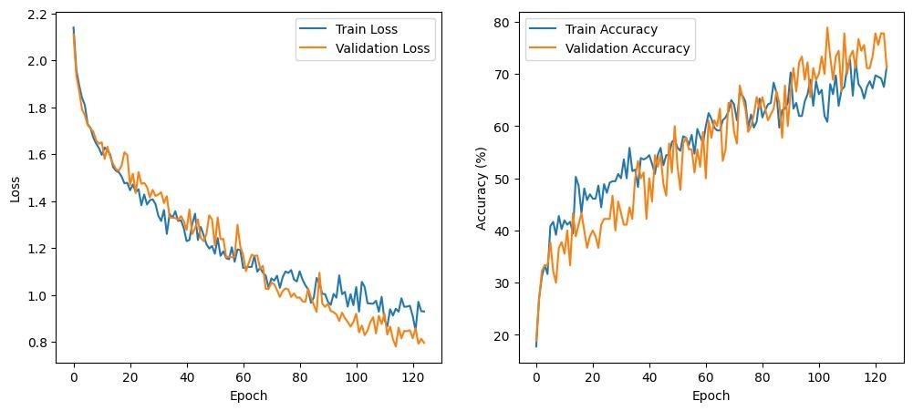
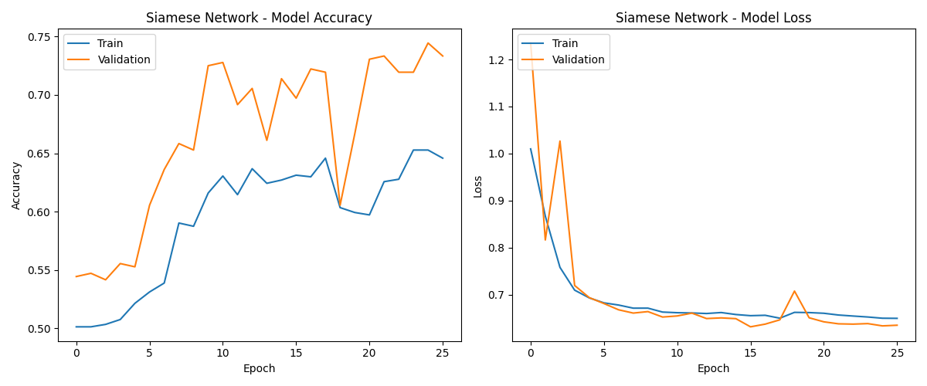
Results
Graphical Neural Network Training History

Slide 23
S.no | Model | Epochs | Precusuib | Accuracy | Recall
1. | MobileNetV2 | 50 | 0.9 | 89.78% | 0.87
2. | Siamese FSL | 50 | 0.58 | 57.66% | 0.49
3. | GNN | 50 | 0.33 | 33.4% | 0.38
4. | Vision Transformer | 50 | 0.54 | 54.44% | 0.66

Slide 24


Slide 25
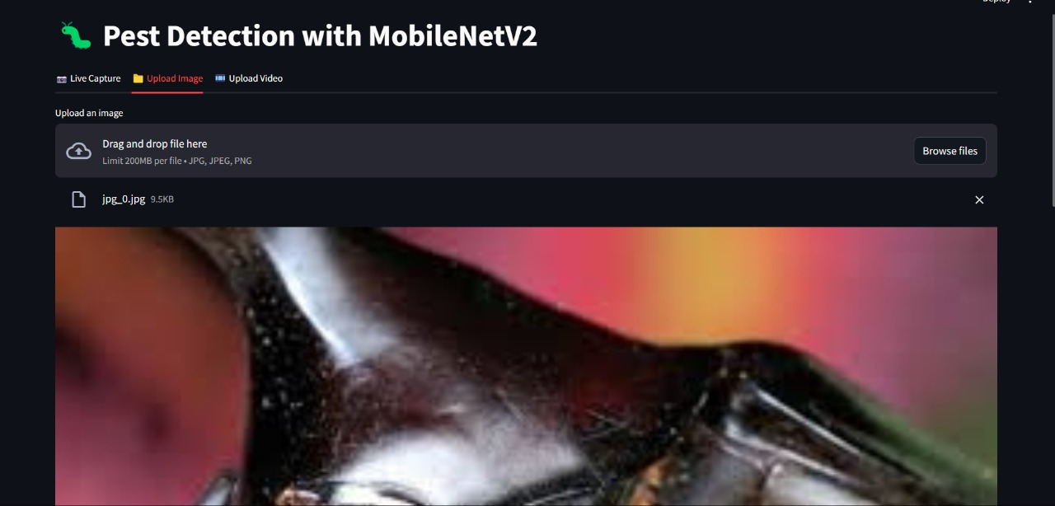

Slide 26
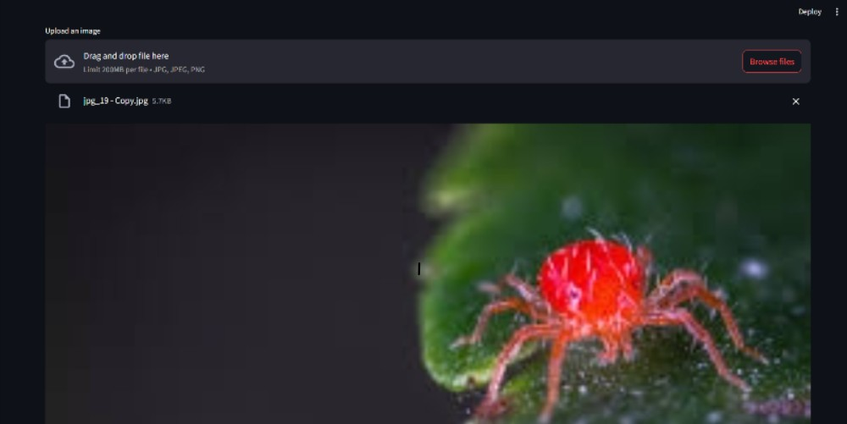

Slide 27
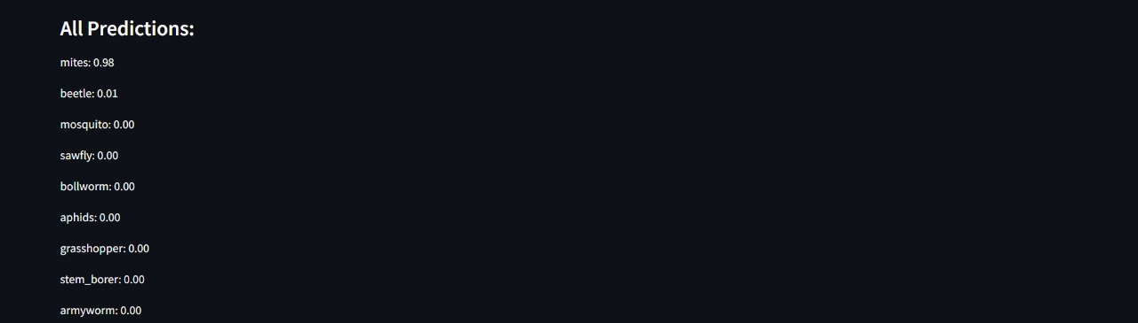

Slide 28
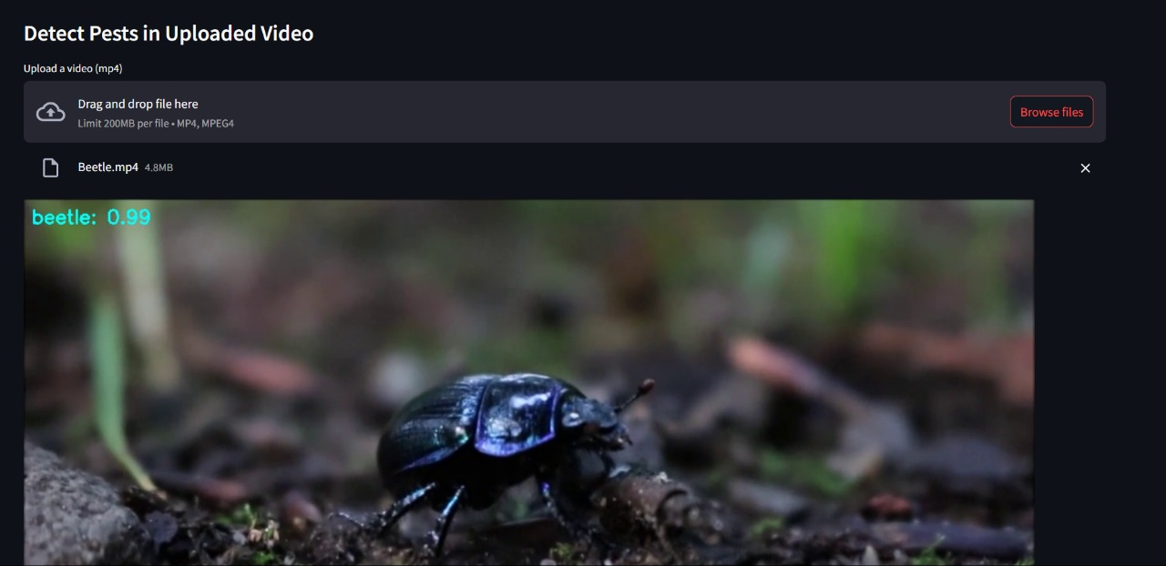

Slide 29
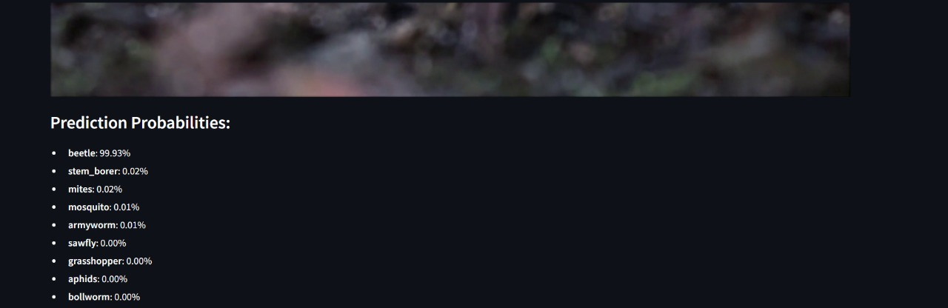

Slide 30
Conclusion
A real-time pest detection system was developed using advanced models such as Few-Shot Learning (FSL), Graph Neural Networks (GNNs), Vision Transformers (ViT), and Self-Supervised Learning (SSL) integrated with MobileNetV2. The system supports live camera feeds, image uploads, and video inputs, processed in real time using OpenCV, and presented through a Streamlit interface. While FSL offers promise for low-data scenarios, its reliance on complex meta-learning and limited computational resources led to reduced accuracy. In contrast, SSL combined with lightweight architectures like MobileNetV2 proved more effective, enabling meaningful pattern learning from unlabeled data and efficient on-device inference. WhatsApp integration allows timely pest alerts, though automated messaging was limited by API constraints. Future improvements include drone-based monitoring, offline SMS alerts, optimized edge deployment, and a hybrid pipeline that dynamically selects the best model based on input and system conditions, enhancing scalability and real-world applicability.

Slide 31
THANK YOU!!

